Slide 1

Adaptive Teaching
Learning to Teach
By Aazim Lakhani
Graduate Student, Department of Computer Science
Supervisor: Dr. Nishant Mehta

Slide 2
Outline
Introduction
Preliminaries
Algorithm
Dataset
Experiments
Results
Conclusion

Slide 3
Outline
Introduction
Preliminaries
Algorithm
Dataset
Experiments
Results
Conclusion

Slide 4
Challenges in Education
One size fits all.
Teachers are overburdened.
Notes:
one-size-fits-all experience in which the teacher selects a learning resource for all students in their class regardless of their diversity in needs, understanding, ability, preferred learning style, and prior knowledge. It is not feasible for teachers to ensure their explanations can cater to all students. Lack of personalization.
No universal way to teach.
Every student is unique.
Need to explore different teaching methods
The main problem with traditional education, which has been perpetual, is the enormous challenge teachers face for being responsible for ensuring every student can acquire expertise in their subject even though students may come from diverse backgrounds and interests.
Every student is unique, so we need to use different teaching methods to find a way that is conducive for a student. Once, we have found it we can use this knowledge to teach other similar students effectively.
This is the exploration-exploitation dilemma where there is a trade-off between exploration (exploring non-stationarity in a student's preferences) and exploitation (maximize a student's satisfaction over a period of time.

Slide 5
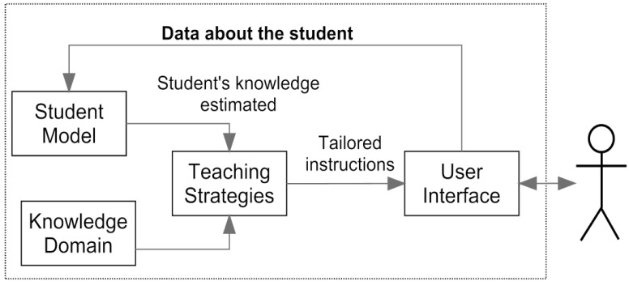
Intelligent Tutoring Systems (ITS)
Basic Architecture of Intelligent Tutoring System
Source: Architecture for an Intelligent Tutoring System that Considers Learning Styles.
Notes:
Pedagogical strategies represented as rules. Students are categorized into groups. They use pre-existing knowledge through assessments, recognize different learning styles and tracks students progress to have intelligently.
ITS comprises of
Content component: Categorizes content for different learning styles that student have.
Student component: Categorizes students into groups based on assessments, learning styles and progress.
Teaching Strategies: Rules that define content to be displayed based on student information.
Give an example of ITS system to show how this operates.

Slide 6
Limitation of ITS
Rules based system.
Believes humans are predictable.
Maintenance of pedagogical rules, re-categorize students in groups.

Slide 7
Machine Learning meets ITS
Overcomes all limitation of ITS.
Personalize learning actions based on interaction with a student.
Always learning.
Notes:
Actions could be reading a book or article, listening to a podcast, watching a video, or interacting with the system by answering quizzes.

Slide 8
Contribution
A learning algorithm, which adapts to student's feedback to help them learn effectively.
Allow students to skip topics they are unlikely to understand.
Notes:
We present a novel baseline algorithm for our proposed adaptive teaching methodology which learns from students and contents for each topic to create a personalized learning path for every student. It adapts dynamically based on student's feedback and learning preferences.
We also provide a skip feature which is meant to keep a student engaged to increase their retention as well as provide feedback to teachers by recognizing the challenges faced by a student early in the course.
Our online learning algorithm gives close to optimal results over a synthesized unbiased heterogeneous dataset.

Slide 9
Outline
Introduction
Preliminaries
Algorithm
Dataset
Experiments
Results
Conclusion

Slide 10
Preliminaries
Multi-Armed Bandits
Contextual Bandits
Upper Confidence Bound
Linear UCB (LinUCB)

Slide 11

Multi-Armed Bandits (MAB)
Bandit “arms”
(unknown payoff probabilities)
p₁
p₂
p₃
“Pulling” arm i yields a reward:
reward = 1 with probability p_{i} (success)
reward = 0 otherwise (failure)
Notes:
For now, we are attacking the problem of choosing best article/arm for all users

Slide 12
Multi-Armed Bandits (MAB)
Bandit “arms”
(unknown payoff probabilities)
p₁
p₂
p₃
Goal: Pull arms sequentially to maximize the total reward
Policy: Sequential algorithm to play arms (items)
Regret = Expected loss relative to the “omniscient” policy that always pulls the best arm
Notes:
But, the best arm is not known unless you have an oracle.
“best” means highest success probability
Regret is the price of exploration
Low regret implies quick convergence to the best

Slide 13

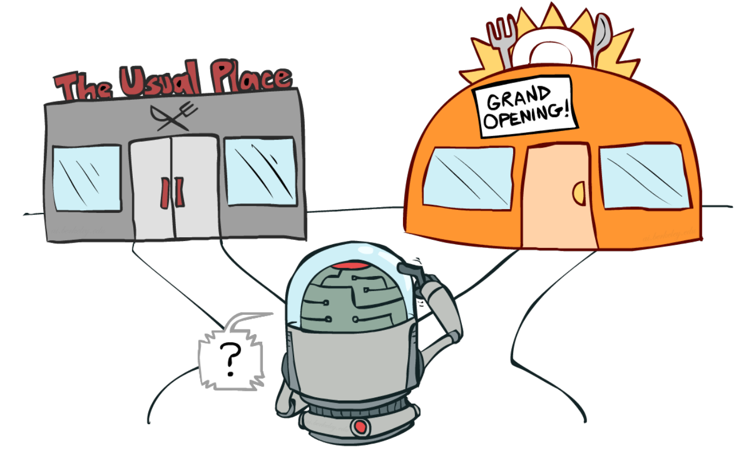
Exploration – Exploitation Tradeoff
Exploitation
Reuse tried and tested arms
Exploration
Lookout for better arms
Src: Pixcove
Src: chatbotsmagazine

Slide 14
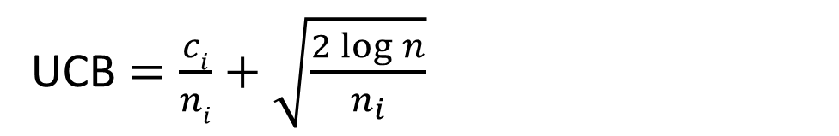
Upper Confidence Bound (UCB)
Estimates the expected reward for each arm by adding estimated sample mean of an arm with it's upper deviation.
Number of successes of arm i
Total number of pulls of all arms
UCB $=\frac{ci}{ni}+\sqrt{\frac{2\log{n}}{n_{i}}}$
Number of pulls of arm i
Sample Mean
Upper Deviation
Notes:
It is based on the principle of \textit{being optimistic} by choosing actions which have the highest potential for reward. The reason this works is that when acting optimistically, one of two things happens. Either the optimism was well justified, in which case the learner is already acting optimally, or the optimism was not justified. In the latter case, the algorithm takes some action that they believed might give a reward when in fact it does not. If this happens sufficiently often, then the algorithm will learn the real reward of this action and not choose it in the future \cite{banditalgs}. UCB algorithms estimate the expected reward for each arm by adding estimated sample mean of an arm with it's upper confidence bound.

Slide 15
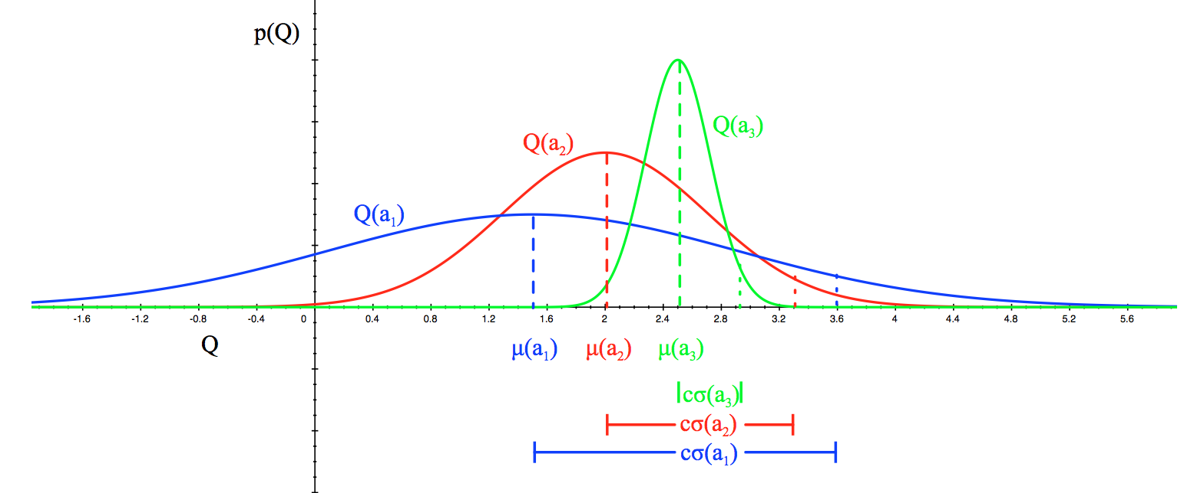
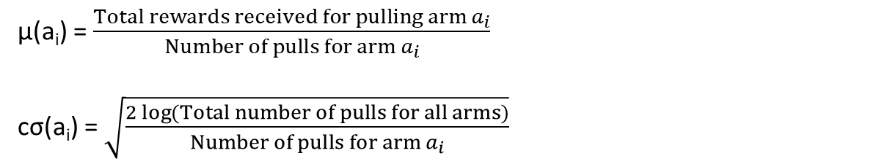
UCB: Example
µ(a_{i}) = $\frac{Total rewards received for pulling{ arm a}_{i}}{{Number of pulls for arm a}_{i}}$
cσ(a_{i}) = $\sqrt{\frac{2\log{(Total number of pulls for all arms)}}{{Number of pulls for arm a}_{i}}}$
Rewards
Notes:
$$\text{Total} \text{reward} \text{received} \text{for} \text{pulling} \text{arm} \text{ai}$$

Slide 16
Limitations of MAB
No personalization

Slide 17
Contextual Bandits
Traditional bandit algorithms do not use any side-information or context.
Contextual bandit algorithms use context to learn and map it to appropriate actions.
Examples: Personalized news article recommendation, clinical decision making on web portals.

Slide 18

Personalized News Recommendation
User visits Yahoo! (with history of previous visits, IP address)
Yahoo! chooses information to present (from news stories, ads)
User reacts to presented information (clicks on something or is not interested)
Goal: Yahoo! wants to choose content and use customer feedback to improve click through rate.
Image Source: Yahoo News

Slide 19

Adaptive Assessment
A student appears for a test.
Assessment system presents a question to test the student.
Student’s answers a question.
The system adapts questions based on student’s ability.
Goal: To help students enhance their knowledge by asking questions which challenge the student
Src: Cartoonstock

Slide 20
Contextual Bandits (CB)
{x_{S} , x_{C}}
Learning Algorithm
E[r_{arm,t}] = f(x_{S} , x_{C} , θ_{arm})
Student context
Content context
Estimated reward at round ‘t’
Compute content item which maximizes reward
GOAL: Maximize rewards by presenting the best content item for each student

Slide 21
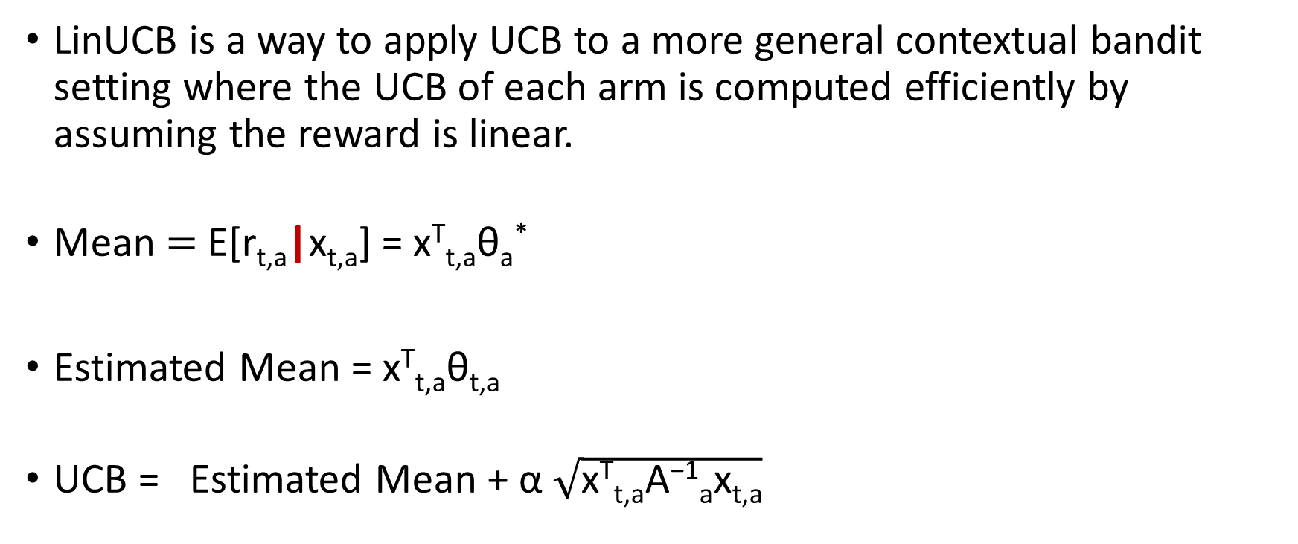
Linear UCB (LinUCB)
LinUCB is a way to apply UCB to a more general contextual bandit setting where the UCB of each arm is computed efficiently by assuming the reward is linear.
Mean $=$ E[r_{t,a}|x_{t,a}] = x^{T}_{t,a}θ_{a}*
Estimated Mean = x^{T}_{t,a}θ_{t,a}
UCB = Estimated Mean + α $\sqrt{\text{x}\text{T}\text{t}\text{,}\text{aA}\text{−1}\text{a}\text{x}\text{t}\text{,}\text{a}}$
Upper deviation
Controls Exploration
Notes:
Why LinUCB ?
1. Computationally fast (Good for experimentation).
2. Most cited and studied algorithms in contextual bandits literature.
3. Theoretical backing.
4. Good empirical results.
5.

Slide 22
Outline
Introduction
Preliminaries
Algorithm
Dataset
Experiments
Results
Conclusion

Slide 23



Adaptive Teaching with CB
Arms
C_1_1
Jargon
Context = Student + Content Context.
Arm = Action = Content Items.
Round = Teach a topic in a specific way.
Reward = Student’s feedback
Contexts
T_1
C_1_2
C_1_3
C_2_1
T_2
C_2_2
Our Goal: Find the best content to teach a student.
C_2_3
C_3_1
Algorithm Objective: Maximize rewards in fewest rounds.
T_3
C_3_2
C_3_3
Notes:
Course Structure:
Presentation:
First show a linear list of topics. Show one content item is associated with each topic. That’s how our we teach in classrooms and MOOC.
Now, we will have different variations of explaining a topic.
Many students would be taking these courses and would be on different topics at any given moment of time.

Slide 24
Basic Version
Prepare context (Student + Content Context).
Use LinUCB to select the best content item for each student.
Teach the student and get their feedback.
Update the parameters of the content presented.

Slide 25
With Skipping
Prepare context (Student + Content Context).
Use LinUCB to select the best content item for each student.
Teach the student and get their feedback.
Update the parameters of the content presented.
Should we skip to the next topic or stay.
Train the skip classifier.

Slide 26
Skip Topics
Use current topic T_{i} to get the next topic T_{i+1} in the sequence.
Compute maximum estimated reward for the next topic T_{i+1}
Pass student context, maximum estimated reward for current and next topic to get a prediction from the skip classifier.
Check the confidence score on the prediction.
Send skip decision.

Slide 27
Skip Topics
Why do we need it ?
Student engagement.
Skip content items which are less likely to help a student.
Teachers recognize topics students struggle with.

Slide 28
Outline
Introduction
Preliminaries
Algorithm
Dataset
Experiments
Results
Conclusion

Slide 29
Dataset
Courses
Student Context
Content Context
Notes:
Our approach to teaching is novel.
We searched for datasets to find if other research groups had performed similar research which we could adapt to use. However, there is no such data. So, now we had the challenge to synthesize data. How do we synthesize data to represent the heterogenous student population without introducing bias. Hence, we used a uniform distribution to create our dataset. Using a

Slide 30
Courses
Course | Topics | Students | Content Items | Content Items per Topic (Average)
1 | 100 | 400 | 720 | 7

Slide 31
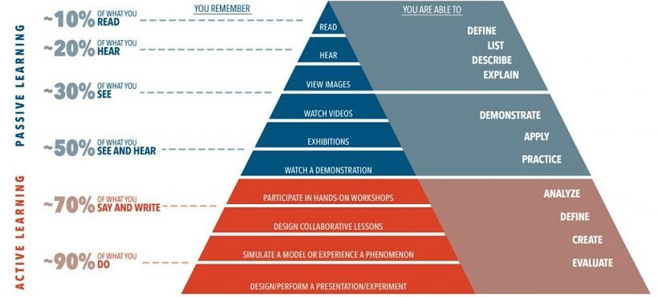
Cone of Learning
Src: Elearningindustry.com

Slide 32
Student Context: An example
Student Context | Preference
Visual | 0.87
Text | 0.82
Demo-based | 0.88
Practical | 0.36
Activity-based | 0.06
Pre-assessment Score | 0.07
Step-by-Step | 0.6
Lectures | 0.66
Audio | 0.56
Self Evaluation | 0.66
This student prefers visual, text, demo-based methods of learning, but does not prefer practical, activity-based, and did not fare well in the pre-assessment. The student does not mind step-by-step, lectures, audios to learn and believes he/she is ready for the course.

Slide 33
Content Context: An example
Content Context | Values
Thorough | 0.91
Practical | 0.88
Experimentally - Sound | 0.97
In-depth | 0.31
Concise | 0.05
Abstract | 0.06
Ease of Understanding | 0.45
Intuitiveness | 0.72
Positive Reviews | 0.75
C_1_1 is a content item for topic 1. It is thorough, practical, and experimentally sound, but not in-depth, concise, and abstract. It is moderate in terms of understanding, intuitiveness and has positive reviews.

Slide 34
Outline
Introduction
Preliminaries
Algorithm
Dataset
Experiments
Results
Conclusion

Slide 35
Experiments
Simulated environment.
Hyper-parameter tuning.
α to control exploration.
Confidence threshold ( C ) to control skipping.

Slide 36




Student View
COURSE
CONTEXT
Get best content item for this student
Learning Algorithm
T_1
C_1_1
:
T_2
C_2_1
:
T_n
C_n_1
:
C_1_10
C_2_15
C_n_10
:
:
Should we skip ?
Teach the student
Request
Simulator
Log the interaction
Update the learning algorithm
Feedback
Student
Train the skip classifier
Notes:
Several students take a course at the same time. Early course takers don’t suffer, while the algorithm learns.
Thus the simulation more closely represents reality.

Slide 37
Hyper-parameter tuning
Scale confidence bound by α
Optimal Confidence Threshold ( C )

Slide 38
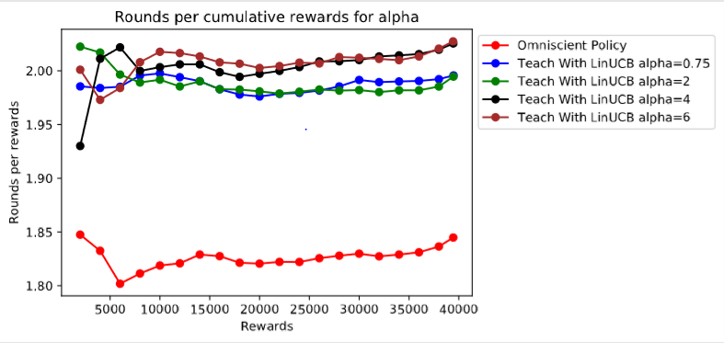
Optimal α

Slide 39
Confidence Threshold ( C )
Why do we need it ?
Maintains student engagement.
Teachers can control skipping.
Skip topics students are unlikely to understand.
Why should we optimize it ?
Low values encourage skipping.
High values prevents skipping.

Slide 40
Optimal Confidence Threshold
Reward per prediction in %
 | Stay | Skip | Total
0 | 25.10 | 18.28 | 43.38
1 | 32.25 | 24.37 | 56.62
C = 0 %
Reward
Reward per prediction in %
 | Stay | Skip | Total
0 | 18.30 | 24.18 | 42.48
1 | 18.30 | 39.22 | 57.52
C = 10 %
Reward
Reward per prediction in %
 | Stay | Skip | Total
0 | 36.82 | 4.09 | 40.91
1 | 50.45 | 8.64 | 59.09
C = 30 %
Reward

Slide 41
Outline
Introduction
Preliminaries
Algorithm
Dataset
Experiments
Results
Conclusion

Slide 42
Results
Learning Algorithm
No skipping.
With skipping.

Slide 43
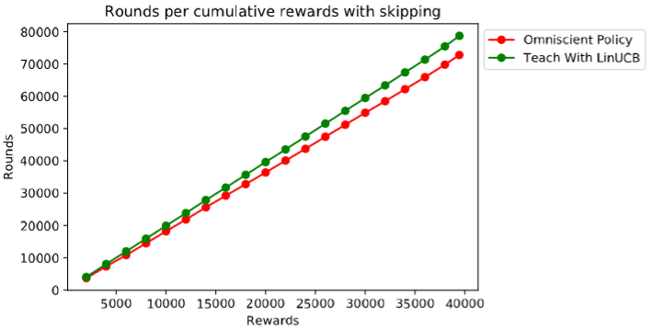
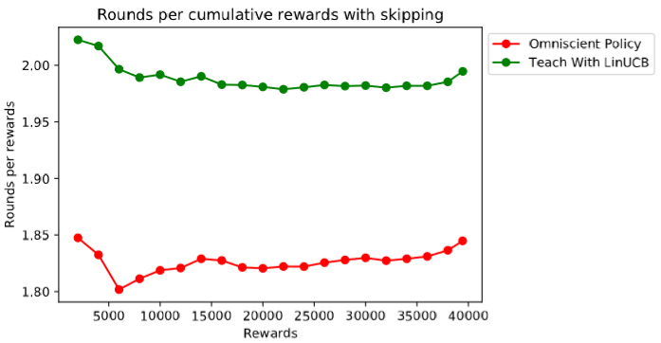
Learning Algorithm – No Skipping
 | Number of rounds | Cumulative Reward | Rounds per rewards
Omniscient | 72,767 | 39444 | 1.84
Teach with LinUCB | 78,707 | 39460 | 1.99
Notes:
Total cumulative reward available was 2500. It so happened that 9 – 10 times the student was unable to understand any content item. This is for a course which has approximately 13 content items.

Slide 44

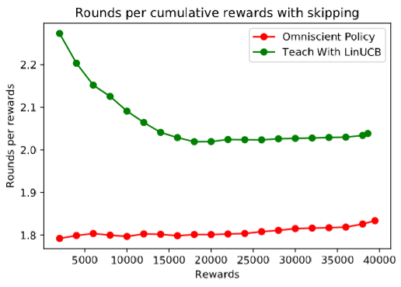
Learning Algorithm – With Skipping
 | Number of rounds | Cumulative Reward | Rounds per rewards
Omniscient | 71,449 | 38,891 | 1.84
Teach with LinUCB | 77,179 | 37,833 | 2.04

Slide 45
Outline
Introduction
Preliminaries
Algorithm
Dataset
Experiments
Results
Wrap Up

Slide 46
Future Work
Engineer features during student interaction.
A course design after the proposed student-centric approach.
Evaluate other algorithms for adaptive teaching.
Optimize skipping so that it does not restrict exploration while still providing the benefits of skipping.
Notes:
Create a course that follows the teaching methods outlined in this project to get real-world student data to evaluate the algorithm.
Design other algorithms for adaptive teaching.
Optimize skipping so that it does not restrict exploration while still providing the benefits of skipping.

Slide 47
Conclusion
Proposed a student-centric approach to teaching.
Synthesized datasets to evaluate the learning algorithm.
Skip topics to improve the teaching and learning experience
Evaluated the learning algorithm with an omniscient policy.
Notes:
A student-centric approach to teaching to personalize learning.
We synthesized a dataset for evaluate Teach with LinUCB.
We evaluated the algorithm by comparing it to the omniscient policy.
We introduced a skip feature to keep students engaged by skipping topics they don’t understand. It helps teachers recognize topics students struggle with.

Slide 48
Thank You

Slide 49
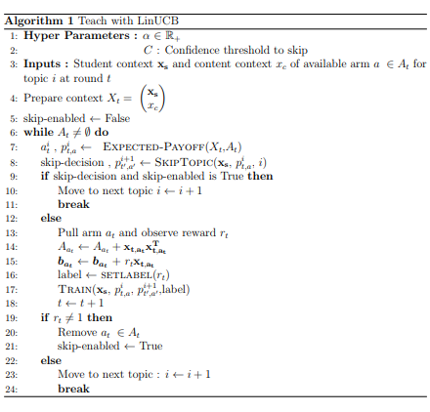
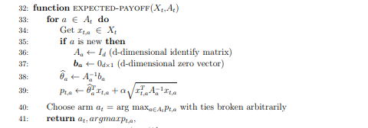
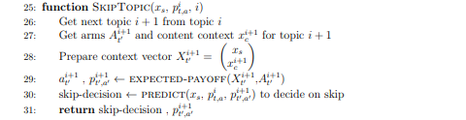
Learning Algorithm
Student preference vector + Content items properties
1
0
3
Decide whether or not to skip to the next topic.
Find a content item which has the maximum expected payoff.
6
Update the arm parameters based on students feedback
7
Train skip classifier

Slide 50
Results
Learning Algorithm
Without skipping.
With skipping.
Value of skipping
With skipping
Without skipping

Slide 51
Adaptive Teaching
Blended Learning
Notes:
1. Blended learning : Use the strengths of both online & traditional learning
2. Teaching sharing resources: Teachers share their teaching resources which shows different ways to teach and the effectiveness of their methods.
3. Ability to teach same topic in different ways to help diverse student.
4.

Slide 52
About Me
Soon to be MSc Computer Science (University of Victoria), CS researcher.
Skills: Full Stack Data Science, Applied Machine Intelligence & Algorithmic Design
Interest : Artificial General Intelligence, System Design

Slide 53
Outline
Challenges
Contextual Bandits
Literature Survey / Prior Work
Teach with LinUCB
Dataset
Experiments
Results & Evaluation
Teacher’s view (Check whether or not to have an apostrophe)
Future Work
Conclusion
Notes:
Challenges: (For teachers, students, why is it a hard problem [non-stationary/temporal behaviour of students] , how to collaborate information from different students, why online learning over batch learning, technical challenges in using data-intensive forms of learning due to lack of data, credit assignment problem)

Slide 54
Learning Algorithm
0
Student preference vector + Content items properties
Find a content item which has the maximum expected payoff.
1
3
Decide whether or not to skip to the next topic.
6
Update the arm parameters based on students feedback
7
Train skip classifier
Notes:
1. Arm refers to a content item. (Arm = Content Item = Explanation for a topic)
2. Payoff is the algorithms upwardly biased estimate of the expected reward, where the bias is due to the algorithms use of upper confidence bound rather than using the sample mean directly.
3. Round comprises of computing the expected payoff for each content item; then presenting a content item with maximum expected payoff and getting student feedback for the content item.

Slide 55
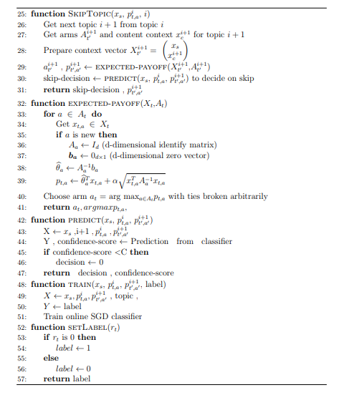
Learning Algorithm
4
Is the student not likely to understand the current topic.
2
From context and content items for a topic present a content item a student is most likely to understand.
5
Are we confident enough that a student is unlikely to understand the current topic.
8
Train the skip classifier to make better predictions

Slide 56

OpenStax Tutor
how they learn — what they struggle with, what helps them most — and it uses that information to tutor them.
The system provides personalized assessment and spaced practice, helping students focus their studying efforts on their weak areas and remember what they learned earlier in the course.
Foucs has been of Customization (Educators and course designers can alter learning or assessment content), Assessment (The presence of academic structures and the capacity to assess learning in relation to them).
Has not yet focussed on Leaner Autonomy (Learners can impact or augment instruction based on their choices), Socio-Emotional (Use of feedback and interventions based on a learner’s social-emotional state), Collaboration ( Ability for learners and/or educators to engage with each other in the context of learning)

Slide 57

Realizeit

Slide 58
Challenges for
Students
Diverse prior backgrounds (culture, knowledge).
Non-stationarity: Student behaviour changes with time.
Student fatigue (Not being able to understand a concept)
Short attention spans. (
Teachers
Difficult to cater the needs of each student.
No universal best way to explain.
Multi-tasking
Notes:
These challenges exist in both offline and online environment.
Offline:
Online:
Multi-tasking: Teaching, observe students reactions, track time.
Short attention spans. Learning happens in phases. Although there are several phases based on the literature you refer to, there are atleast two phases which concern this point. Absorption & Introspection. This is true in any conversation. You first listen to the information and then think about it. Students do this at different rates. Teachers cannot factor this information, due to lack of well known metric for every classroom.

Slide 59
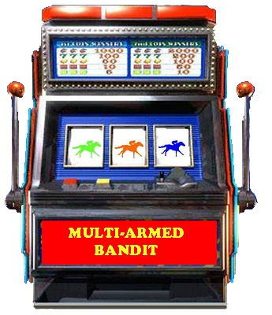
Multi-Armed Bandits
A problem setting where an agent makes a sequence of decisions in time t = 1, 2, ..., T. At each time t the agent is given a set of K arms to choose and has to pull an arm. On pulling an arm, it receives a reward for that arm, while the rewards of other arms cannot be determined.
A/B Testing + Explore – Exploit = Multi-Armed Bandits

Slide 60
Why MAB ?
Explore-Exploit.
Solving Credit Assignment Problem versus student fatigue
Notes:
Solving Credit Assignment Problem versus student fatigue: The challenge with traditional reinforcement learning is that its difficult to recognize the actions which affected rewards. This is due to lack of feedback at every step. Applying reinforcement learning for our use case would not be feasible as it would cause student fatigue (as the agent would try to find what the student did not understand & in process that student would feel disillusioned with the system). The system would require large number of data points to learn & give effective results. It’s a good solution for a later date, but not when you don’t have sufficient data.

Slide 61
Explore - Exploit
MAB algorithms (UCB, Bayes, epsilon greedy, softmax, EXP3, EXP4

Slide 62
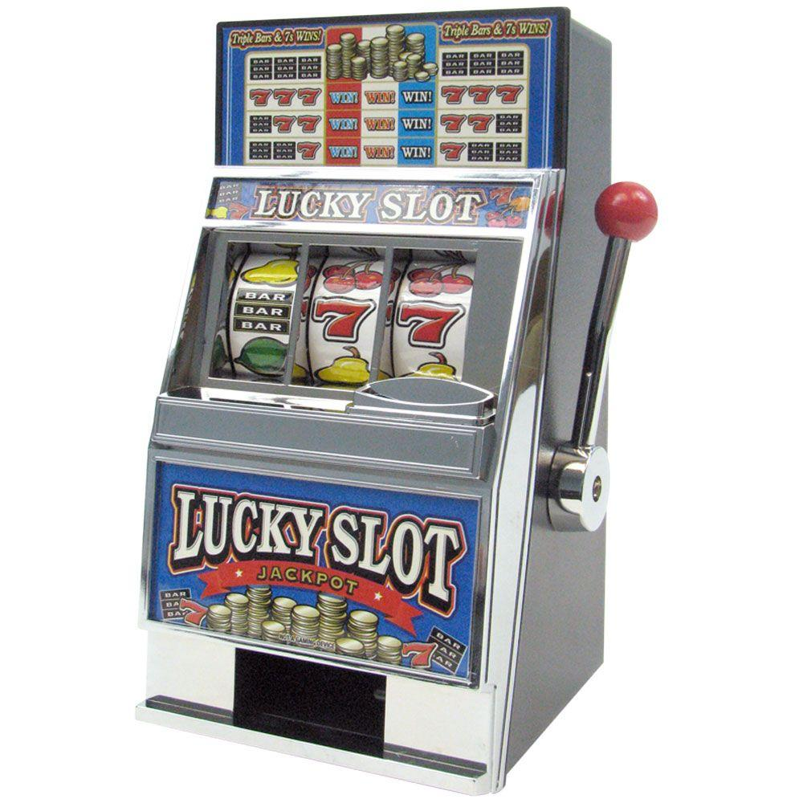

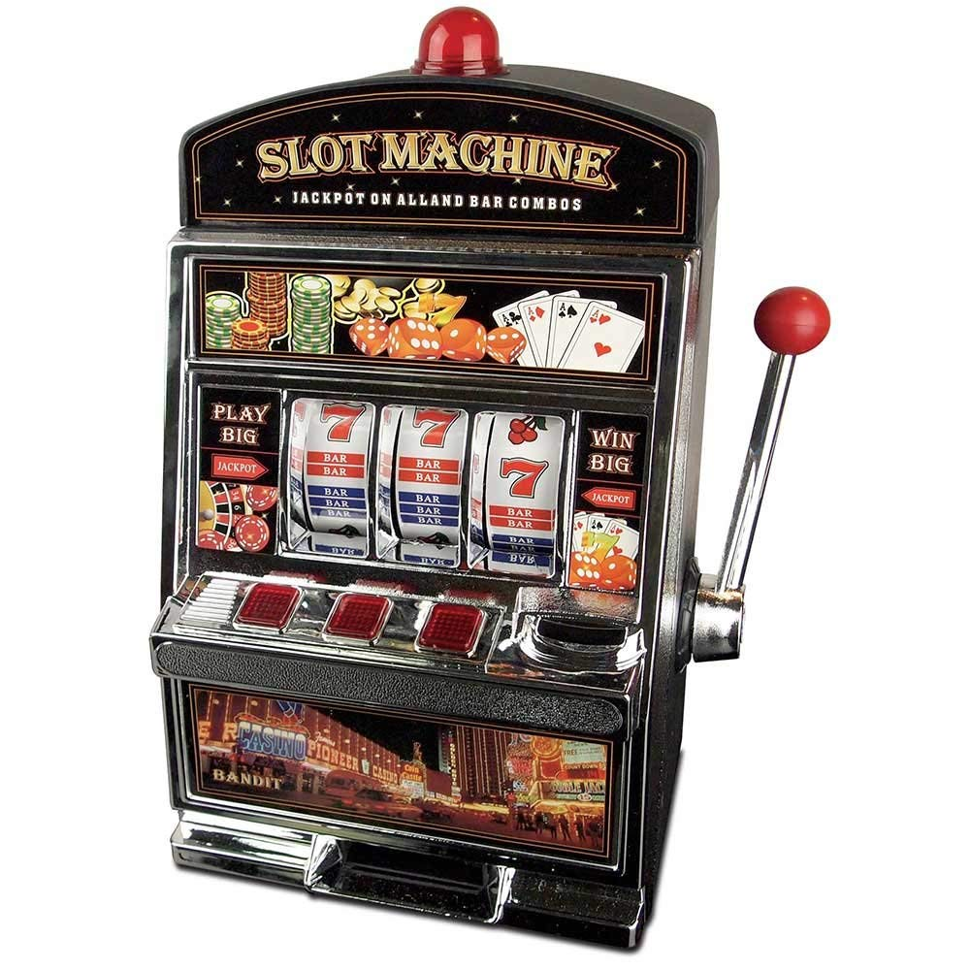
Example
A
B
C
µ_{A} = ( r_{A,1} + r_{A,4}+ r_{A,6} ) / n_{A}
µ_{B} = ( r_{B,3} + r_{B,7} ) / n_{B}
µ_{C} = ( r_{C,2} + r_{C,5} ) / n_{C}

Slide 63
Solutions
ε-greedy: Pull a random arm ‘ε’ times. Pull the best arm ‘1- ε’ times
Decaying ε: Same as above, except ε decays with time
Pure exploration till time ‘t’, then pure exploitation
Bayesian Bandits: Draw an estimation from Beta-distribution
Adversarial Bandits:
SoftMax:
Upper Confidence Bound:

Slide 64
Multi-Armed Bandits: Minimax Approach (2)
As total observations n becomes large:
Observed payoff tends asymptotically towards the true payoff probability
The system never completely “converges” to one best arm; only the rate of exploration tends to zero
Observed payoff
Factor representing uncertainty

Slide 65





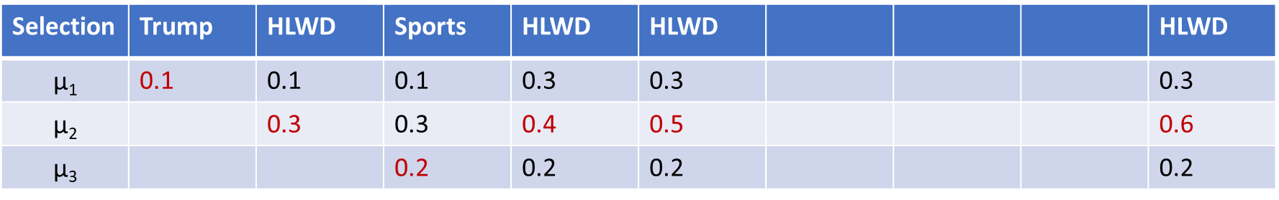

Explore-Exploit
$$\text{µ}\text{1}=0.8$$
$$\text{µ}\text{2}=0.6$$
$$\text{µ}\text{3}=0.4$$
time
t₁ t₂ t₃ t₄ t₅ t₆ t₇ ………………. t∞
Selection | Trump | HLWD | Sports | HLWD | HLWD |  |  |  | HLWD
$$\text{µ}\text{1}$$ | 0.1 | 0.1 | 0.1 | 0.3 | 0.3 |  |  |  | 0.3
$$\text{µ}\text{2}$$ |  | 0.3 | 0.3 | 0.4 | 0.5 |  |  |  | 0.6
$$\text{µ}\text{3}$$ |  |  | 0.2 | 0.2 | 0.2 |  |  |  | 0.2
Notes:
Try to animate this slides to have required data displayed on clicking a key.

Slide 66
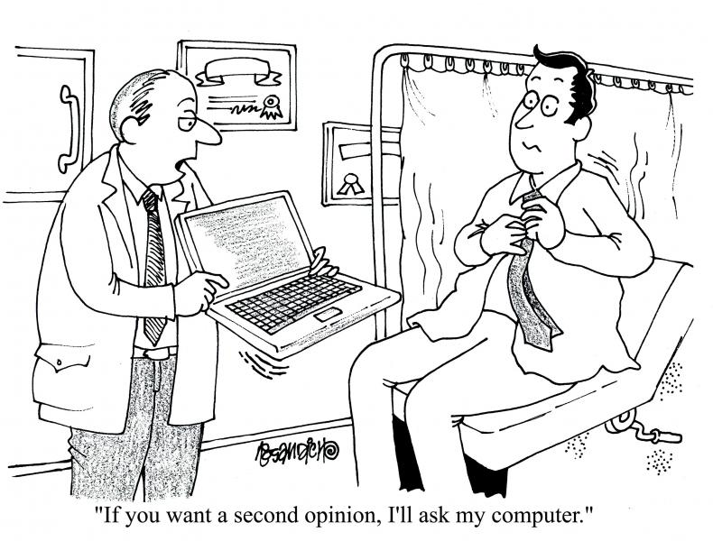
Clinical Decision Making
Patient visits a doctor with symptoms, medical history, test results.
Doctor chooses a treatment.
Patient responds to it.
Goal: Doctor wants a policy for choosing targeted treatments for individual patients

Slide 67

Contextual Bandits (CB)
A -> {x_{A,1} x_{A,2} , x_{A,3} ……..}
E[r_{A,t}] = f(x_{A,1} x_{A,2} , x_{A,3} ….)
B -> {x_{B,1} x_{B,2} , x_{B,3} ……..}
E[r_{B,t}] = f(x_{B,1} x_{B,2} , x_{B,3} ….)
C -> {x_{C,1} x_{C,2} , x_{C,3} ……..}
E[r_{C,t}] = f(x_{C,1} x_{C,2} , x_{C,3} ….)
Contexts: User’s prior visits, patients symptoms, student’s learning style
Reward: Articles CTR, patients response to treatment, student’s feedback.

Slide 68
Online Learning
Cold start
New items or new users come to the system
How to obtain data for new items/users (explore/exploit)
Once data becomes available, how to quickly update the model
Periodic rebuild (e.g., daily): Expensive
Continuous online update (e.g., every minute): Cheap
Concept drift
Item popularity, user interest, mood, and user-to-item affinity may change over time
How to track the most recent behavior
Down-weight old data
How to model temporal patterns for better prediction
… may not need to be online if the patterns are stationary
Notes:
Cold start
New items or new users come to the system
How to obtain data for new items/users (explore/exploit)
Once data becomes available, how to quickly update the model
Periodic rebuild (e.g., daily): Expensive
Continuous online update (e.g., every minute): Cheap
Concept drift
Item popularity, user interest, mood, and user-to-item affinity may change over time
How to track the most recent behavior
Down-weight old data
How to model temporal patterns for better prediction
… may not need to be online if the patterns are stationary
******************************************************************************************
Why online model? Real systems are dynamic!!
Cold-start problem: New users/items come to the system
New data should be used a.s.a.p., but rebuilding the entire model is expensive
How to efficiently, incrementally update the model
Similarity-based methods, PLSI, linear and factorization models
Concept-drift problem: User/item behavior changes over time
Decay the importance of old data
State-space model
Explicitly model temporal patterns
timeSVD++ for Netflix, tensor factorization
****************************************************************************************
Online learning helps learning on the go/incremental online update

Slide 69
Student Context
Context | Preferance towards
Visual (S_V) | Visual explanations (video, short-film, movie-clip, video blog's)?
Text (S_T) | Written explanations (books, articles, blogs, research papers).
Demo-based (S_D) | Live experiments to help understand a concept.
Practical (S_P) | Explanation followed by a demo and hands on.
Step-by-step (S_S) | Guidance to practice to try and understand a topic in a systematic way.
Activity/Task-based (S-AT) | Content items which are interactive and require students participation.
Lecture (S_L) | Passive listening to an expert explain a topic.
Audio (S_A) | Audio explanations (podcast, music)
Self-evaluation (S_SE) | Self-evaluation to know course readiness, motivation, excitement.
Pre-assessment (S_PA) | Pre-assessment of the pre-requisites for the course
Notes:
What is correlation ? When can we say multiple features are correlated ?
Notion of weak and strong correlation.
Understanding of correlation does not imply causation. When does correlation relate directly to causation. Are there such situations, where this is a valid ?

Slide 70
Content Context
Context | Preferance towards
Ease of understanding (C_E) | How easy is it to understand the topic ?
Simple/Intuition (C_I) | How simple, intuitive is it ?
Surface/In-depth (C_ID) | How surface based or in-depth does it cover the topic ?
Brief/Concise (C_C) | How short, to the point is it ?
Thorough (C_T) | How well does the content item cover the topic?
Well reviewed/rated(C_R) | What well rated is it ?
Theoretical/Abstract (C_A) | How theoretical or abstract is the content item?
Practical/Hands on (C_P) | Can it be tried or experienced?
Experimental/Task-based (C_ETB) | How task oriented is it ? For e.g.: Collaboration with other students or some research/findings?
Notes:
What is correlation ? When can we say multiple features are correlated ?
Notion of weak and strong correlation.
Understanding of correlation does not imply causation. When does correlation relate directly to causation. Are there such situations, where this is a valid ?

Slide 71
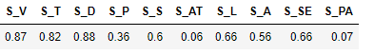
Student Context: An example
This student prefers visual (S_V), text(S_T), demo-based(S_D) methods of learning, but does not prefer practical (S_P), activity-based(S_AT), and did not fare well in the pre-assessment(S_PA). The student does not mind step-by-step(S_S), lectures(S_L), audios(S_A) to learn and believes he/she is ready for the course (S_SE).
Notes:
A student context data point which shows a student preference.

Slide 72
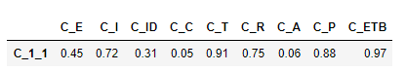
Content Context: An example
C_1_1 is a content item for topic 1 for a course. It is thorough(C_T), practical(C_P), and experimentally sound(C_ETB), but not in-depth(C_ID),concise(C_C), and abstract(C_A). It is moderate in terms of understanding(C_E), intuitiveness(C_I) and has positive reviews(C_R).
Notes:
A student context data point which shows a student preference.

Slide 73
Learning Algorithm
Learning Algorithm
Get best content item for this student
Context
Should we skip ?
Teach the student
Simulator
Log the interaction
Update the learning algorithm
Feedback
Student
Train the skip classifier

Slide 74


Student View
COURSE
T_1
C_1_1
:
T_2
C_2_1
:
T_n
C_n_1
:
C_1_10
C_2_15
C_n_10
:
:
Request
CONTEXT
Notes:
Several students take a course at the same time. Early course takers don’t suffer, while the algorithm learns.
Thus the simulation more closely represents reality.

Slide 75
Learning Algorithm
Learning Algorithm
Get best content item for this student
Context
Should we skip ?
Teach the student
Simulator
Log the interaction
Update the learning algorithm
Feedback
Student
Train the skip classifier

Slide 76
Solutions
Multi-Armed Bandits (For no dataset, to acquire data & explore)
Online Learning (Overcome cold start, temporal changes)

Slide 77
MAB for Teaching

Slide 78
Courses
Course | Topics | Students | Content Items | Content Items per Topic (Average) | Use
1 | 10 | 50 | 119 | 12 | Optimal hyper-parameters
2 | 25 | 100 | 329 | 13 | Evaluation
3 | 100 | 400 | 720 | 7 | Scalability

Slide 79
Uniform versus Normal Distribution
Uniform
Normal
Diagram of uniform distribution over a feature
Diagram of uniform distribution over a feature.
Notes:
A normal distribution is symmetric about the mean. However, real world data is not always symmetric. It could be skewed. How do we decide whether the data should be skewed towards the left or right. We wanted our dataset to represent diverse student population and a skewed dataset would not help us accomplish it.
We did not want to make strong assumptions about a dataset which when there is no conclusive literature supporting a claim.

Slide 80
Future Work
Spaced learning (Repeating concepts to maximize retention)
Spaced feedback (to promote flexibility, rather than questions at every level)
Map feedback received to concept not understood (Need data and labelling to learn/Credit assignment problem)
Making a decision and updating the model in real time is expensive and not scalable. Batch updates (e.g: every 5 minutes) is more feasible.

Slide 81
Experimental Set Up
Dataset
Courses
Student Context
Content Context
Simulated Environment
Student View
Learning Algorithm
Hyper-parameter tuning
Optimal α
Optimal Confidence Threshold ( C )
Notes:
Dataset
Courses
Student Context
Content Context

Slide 82
Sequence Diagram showing all interactions

Slide 83
Rounds
Payoff (if you are using)
Reward

Slide 84
Contextual Bandits in Adaptive Teaching
Context = Features
Model correlation through covariance/features
Input: Student preference vector + Content items properties
Output: Mean and upper confidence bound of the content item based what we learnt so far.
Rate content items to find one that would maximize rewards.
Update the model based on students feedback/response

Slide 85
Assumptions
Dataset is representative of students.
Notes:
Dataset is representative of students: Covers the diversity of students, contextual features, features have been mined from relevant sources (we don’t focus on how the features are extracted, data is pre-processed. Dimensionality reduction is assumed to be done. It helps speed up learning.
A course is created using the proposed teaching methodology. Every topics has ‘n’ content items, where ‘n’ is a natural number greater than or equal to 1.

Slide 86
Context
Context = Features
Student Context
Context Context
How could we collect context in real world ?
Dynamic Feature Collection
Scientific Experimental Set Up
Surveys
Notes:
Scientific Experimental Set Up: No need to open up and the brains and watching what is going on. An experimental student groups representing diverse students would help us gain an understanding that could help future generations.
Reliably generalizing features of teaching material, methods and strategies is a different field of research.

Slide 87
Evaluation
How do you evaluate your algorithm when
No pre-existing labelled dataset
No pre-existing benchmark algorithms.
Train / Test split ?
Notes:
Train / Test split : This would required a large amount of data. Also, there is no defined notion of good content versus content that not good. A good content is one that a student understands. That does not mean that content would be good for every student, as another students with a different prior knowledge might not find it useful or good enough to help them understand. Lets take an example.
George and Nishant are students taking a class. They are totally different students in terms of how they absorb information & think through it. Say, we’re trying to evaluate our algorithm using the conventional method of evaluation, the train/test split. This data is labelled to measure how well our algorithm has learnt. Labelled as consistent, which means a cat would always be a cat.
For adaptive teaching, lets say we have a train / test split, which is labelled. What if our learning algorithm predicted a different content item than the one labelled ? Does it mean its prediction is bad ? Well that’s subjective. If the student gives a reward then it is good. Without reward is probably not good for this student.
Point is, there is no perfect notion of right or wrong. Unless you try you won’t find out if a content item would give a reward. However, if we keep trying different content items, it is likely that students could feel disillusioned with a system that does not understand their needs. That’s where skipping comes in.
Skipping gives teachers feedback on topics students are actually struggling with. They can use this information to drive their classrooms to help students learn topics they actually need help with.

Slide 88
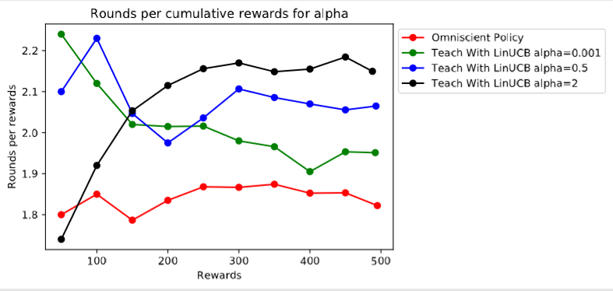
Optimal α
Values of α | Content Items Explored
0.001 | 64
0.5 | 79
2.0 | 81

Slide 89
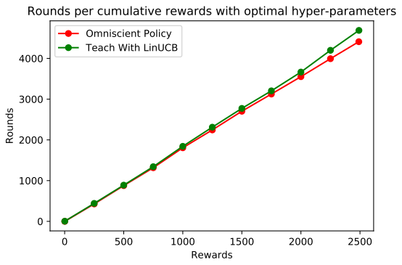
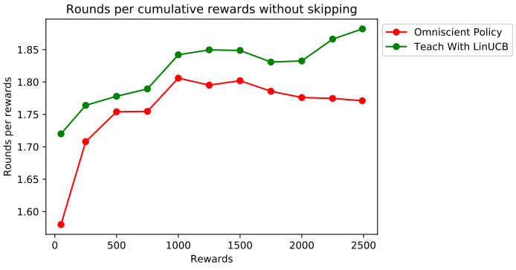
Learning Algorithm – No Skipping
 | Number of rounds | Cumulative Reward | Rounds per rewards
Omniscient | 4410 | 2490 | 1.77
Teach with LinUCB | 4688 | 2491 | 1.88
Notes:
Total cumulative reward available was 2500. It so happened that 9 – 10 times the student was unable to understand any content item. This is for a course which has approximately 13 content items.

Slide 90
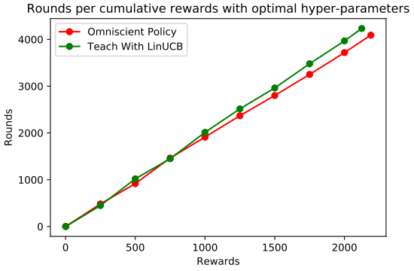
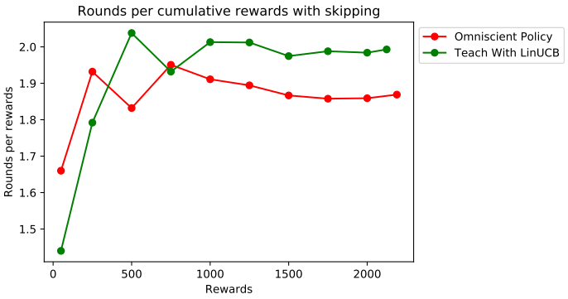
Learning Algorithm – With Skipping
 | Number of rounds | Cumulative Reward | Rounds per rewards
Omniscient | 4019 | 2128 | 1.89
Teach with LinUCB | 4185 | 2062 | 2.03

Slide 91
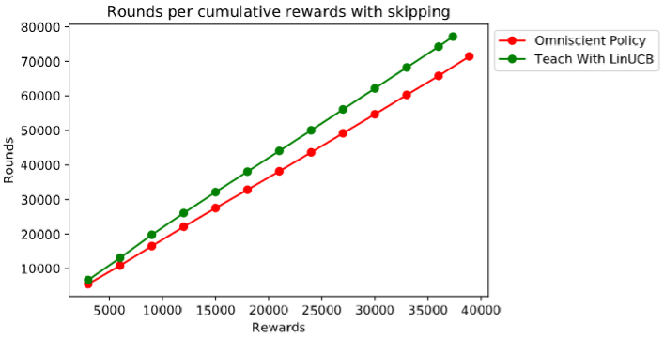
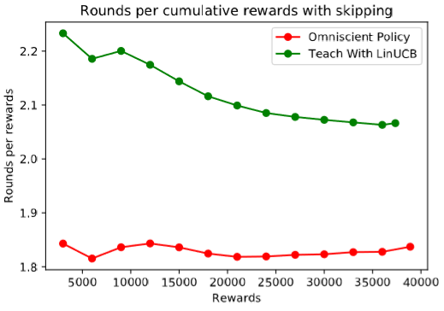
Learning Algorithm - Scalability
 | Number of rounds | Cumulative Reward | Rounds per rewards
Omniscient | 71,449 | 38,891 | 1.84
Teach with LinUCB | 77,179 | 37,350 | 2.07

Slide 92
Technical Challenges
Non-stationarity in student behaviour.
Cold start.
No available dataset.
Evaluate without pre-existing benchmarks using omniscient policy
Notes:
1. Temporal changes : Non-stationarity.
2. Cold start : Lack of historical data.
3. Dataset :
4. No best universal way to teach every student : Approach varies based for every student. How do we find the best way to teach every student ? (Ans: Explore-exploit for personalization). Best way depends on the student being taught (their learning style & other intrinsic factors) and manner in which a topic is taught.
5. Similarity between students : Every student is unique, but there are plenty are similarities between different students. How do we leverage this. How do we transfer our learnings from one student to another similar student.
6. Help teachers to facilitate and remediate students: Teachers role should not diminish. Instead, there is a need to help them focus on other aspects to personalize the learning experience.
7. Help students learn how they prefer to learn: Students learn in different ways. How do we teach them in a way they understand without affecting other students.

Slide 93
Solutions
Using our algorithm a unique learning path is created for each student.
Use similarity across students to teach them.
Treat each student as a unique individual.
Notes:
Help teachers to facilitate and remediate students.

